Slide 1
Online Quiz System
Viridiana Delgado - 007694031
George Sanchez - 004138692
Isaac Aguinaga - 008486667
Arthur King - 007787488

Slide 2
Description:
Our group project consists of a full-stack Online Quiz System that allows users to register, log in, create quizzes, and take quizzes. The system is built with a HTML, CSS, and JavaScript frontend while using Node.js and Express backend. The system uses MongoDB for data storage, handling users, quizzes, and results.
Main Features:
User registration, login, and logout
Displays account details
Making quizzes
Taking Quizzes

Slide 3
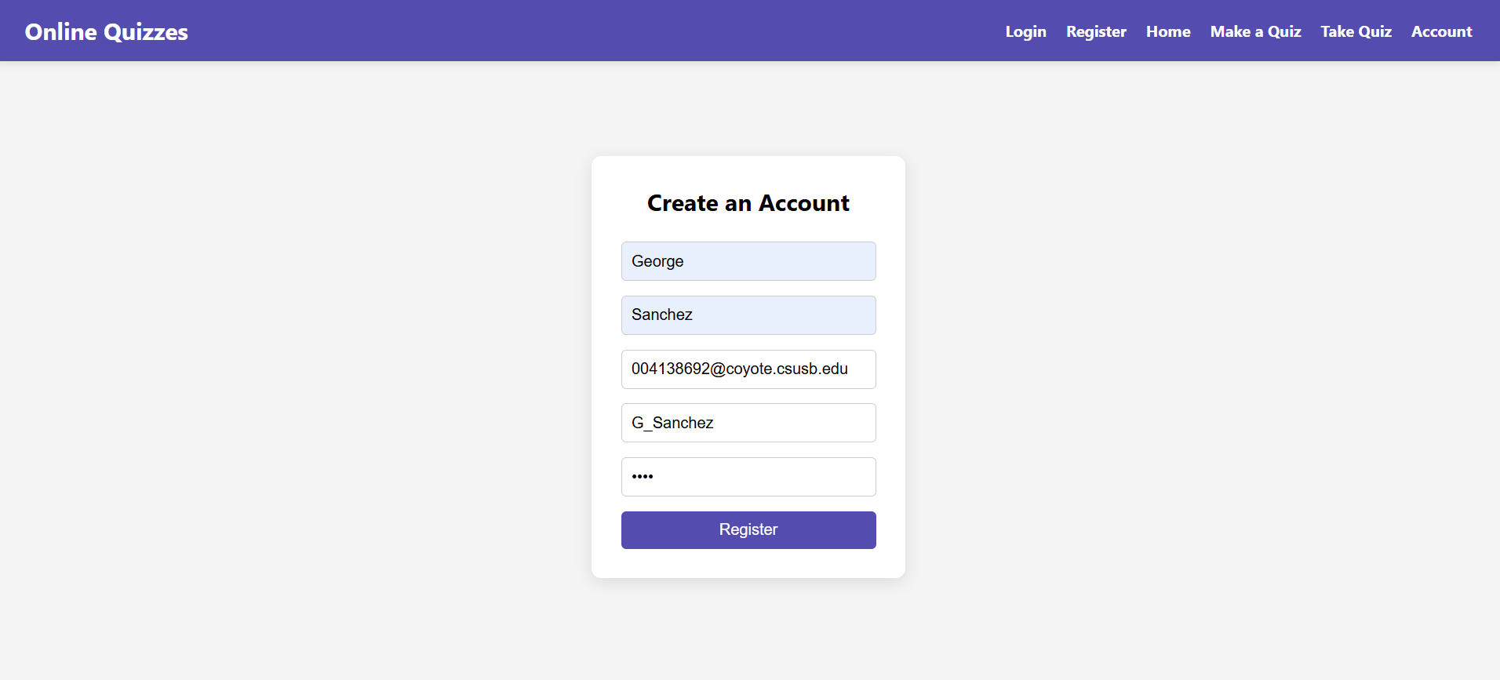
User Registration

Slide 4
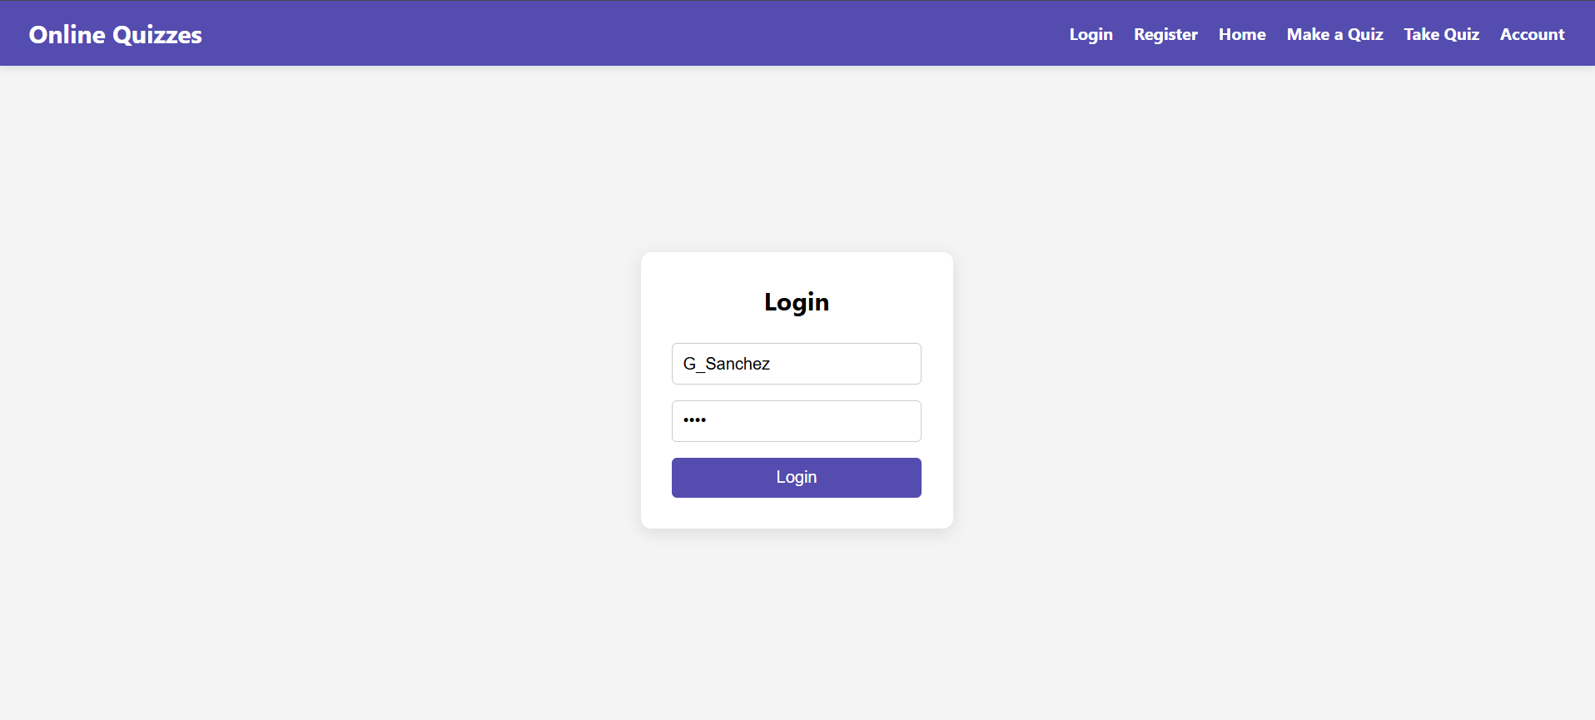
User Login

Slide 5
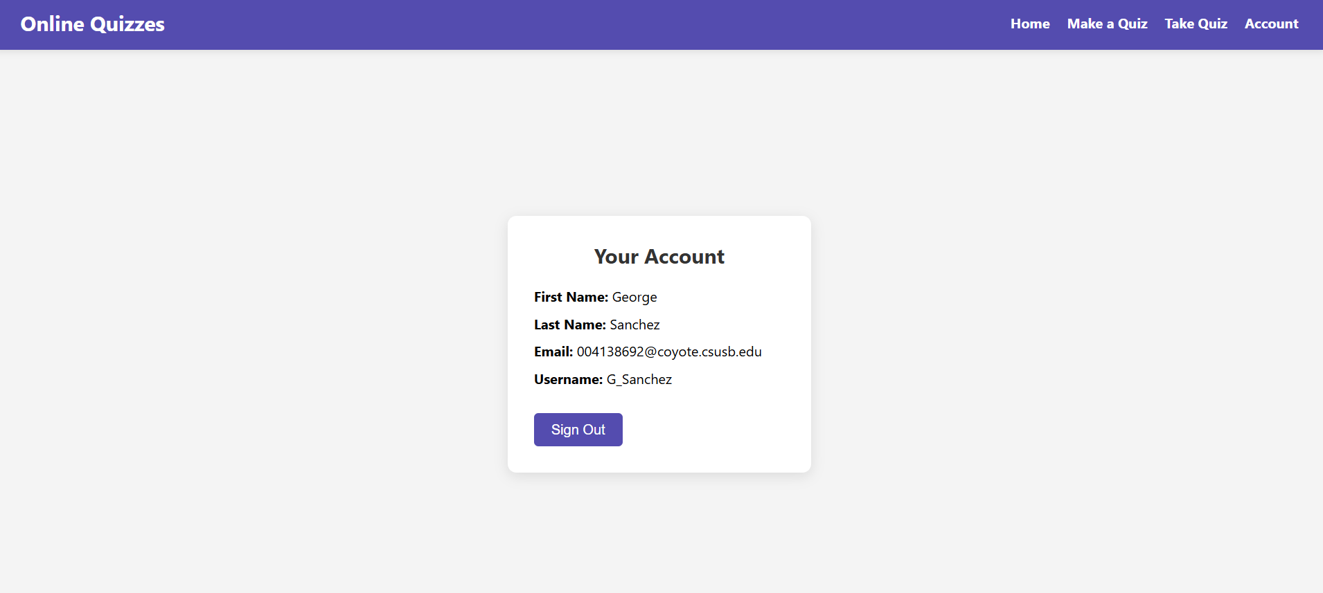
User Details/Logout

Slide 6
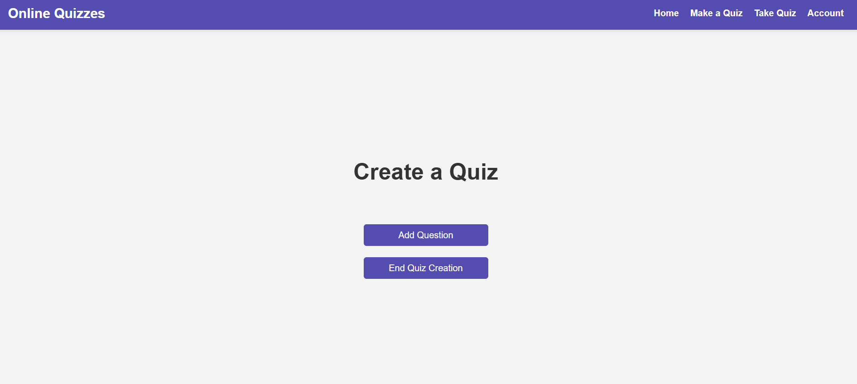
Make Quiz

Slide 7
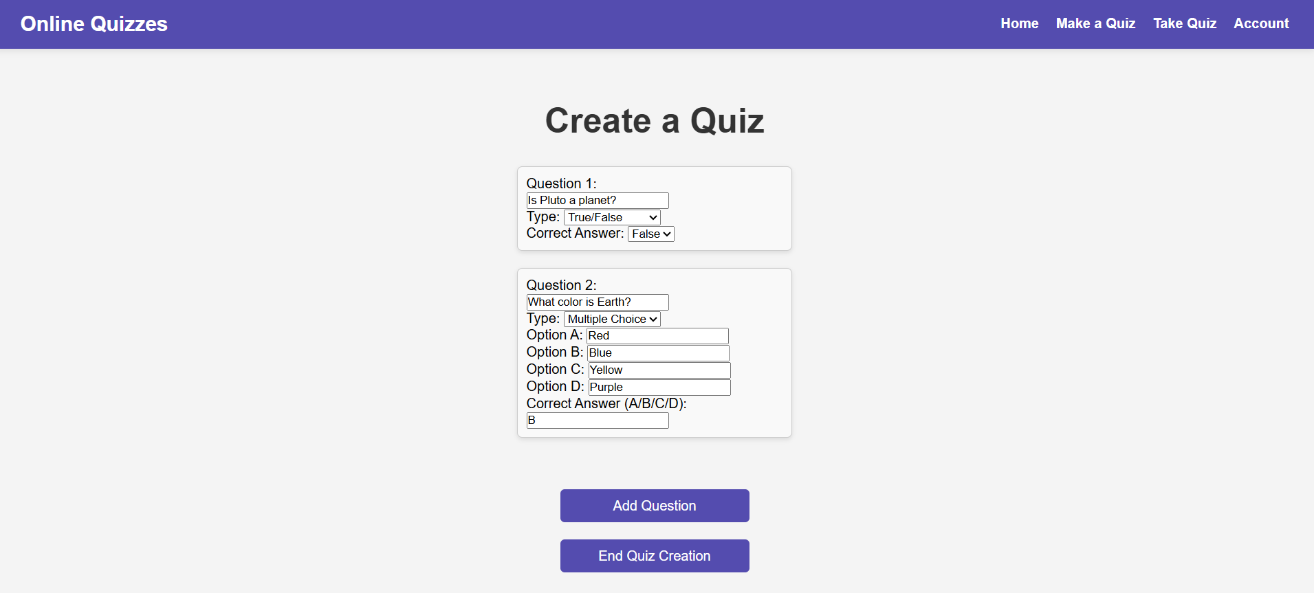
Make Quiz

Slide 8
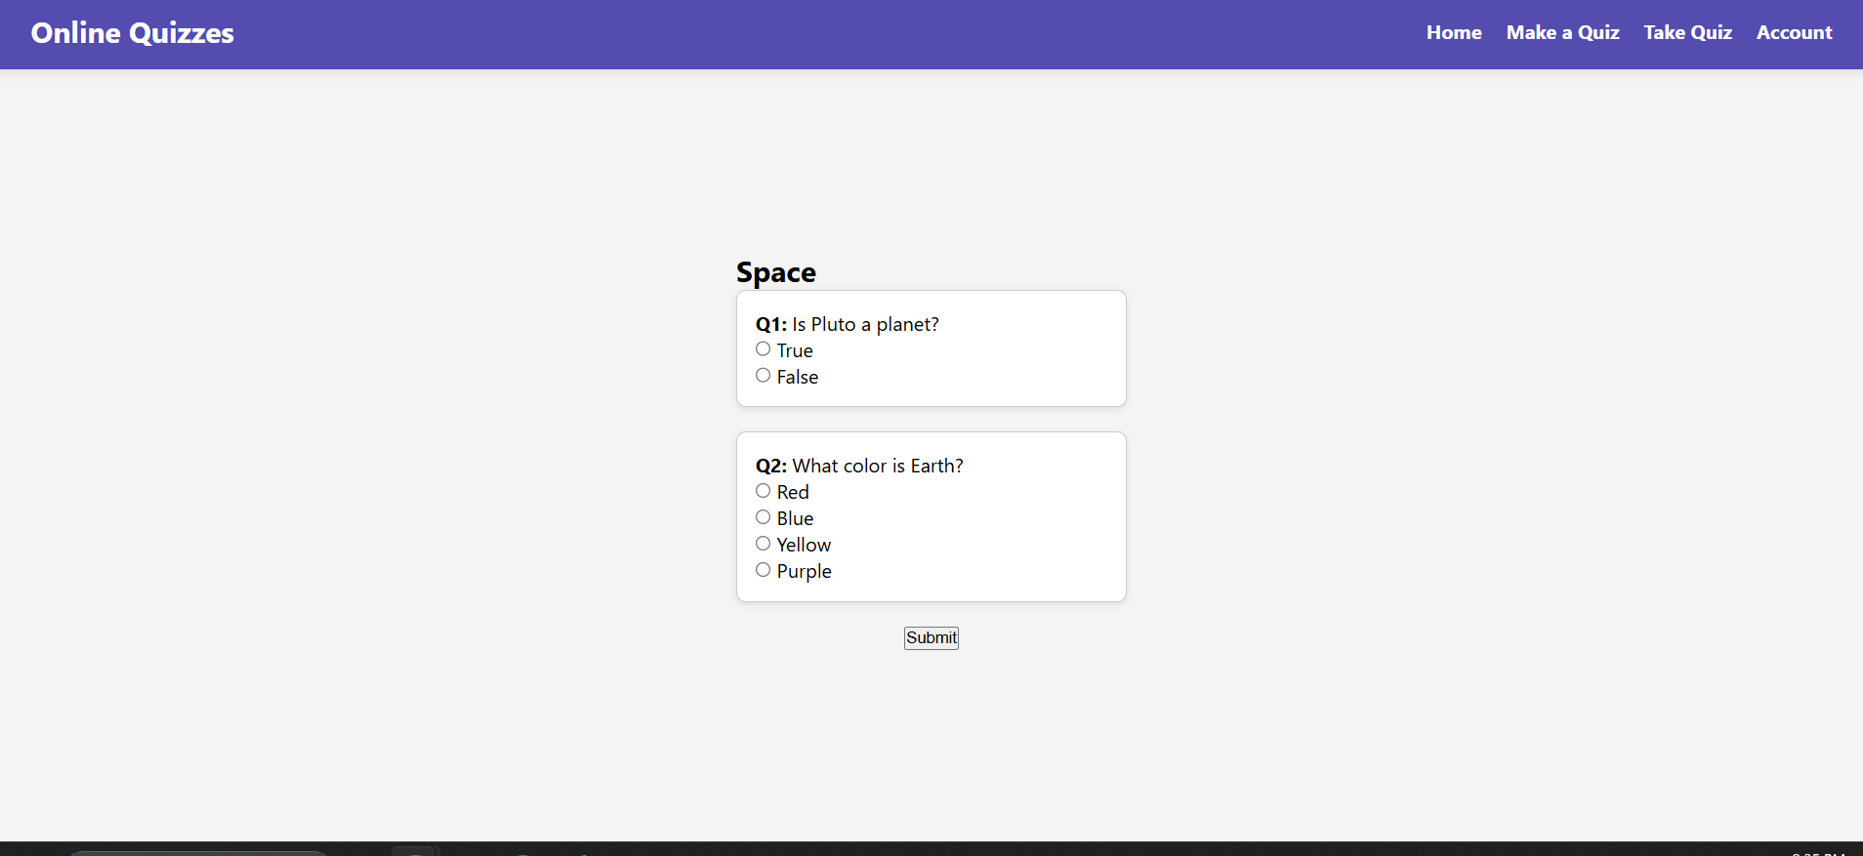
Take Quiz

Slide 9
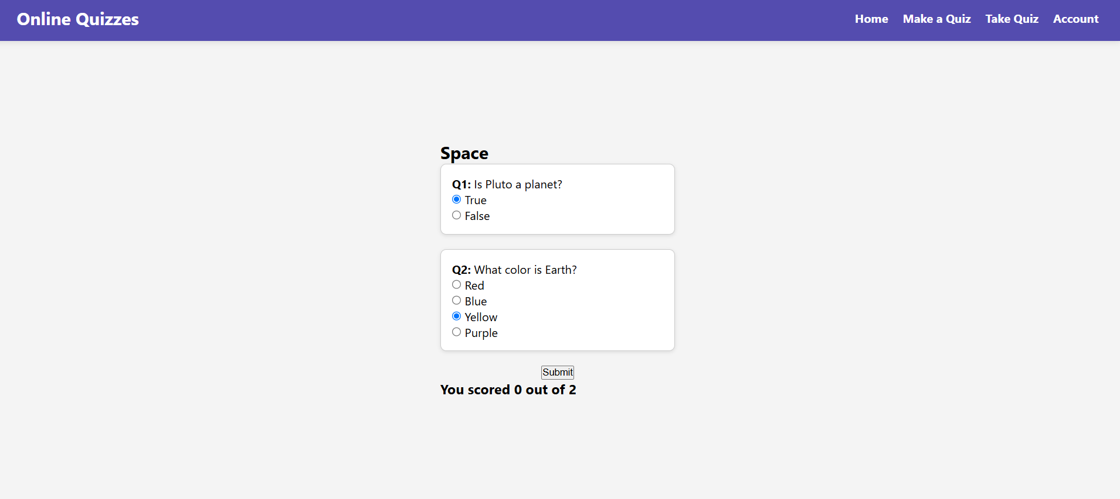
Take Quiz

